Slide 1
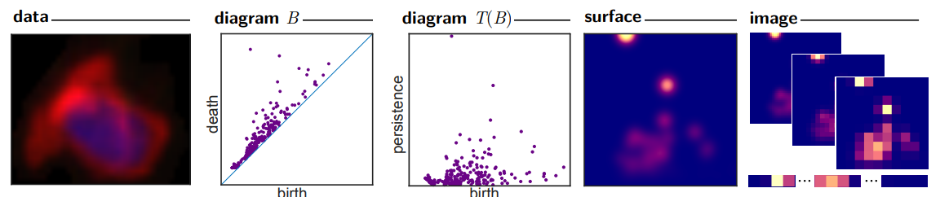
Persistence Images: A Stable Vector Representation of Persistent Homology

Slide 2
I like the idea of “Persistence Images”
From the paper Adams, Henry, et al. "Persistence images: A stable vector representation of persistent homology." Journal of Machine Learning Research 18 (2017).
Would be a great tool for classification. A CNN could quickly classify damage from a resistance image.

Slide 3
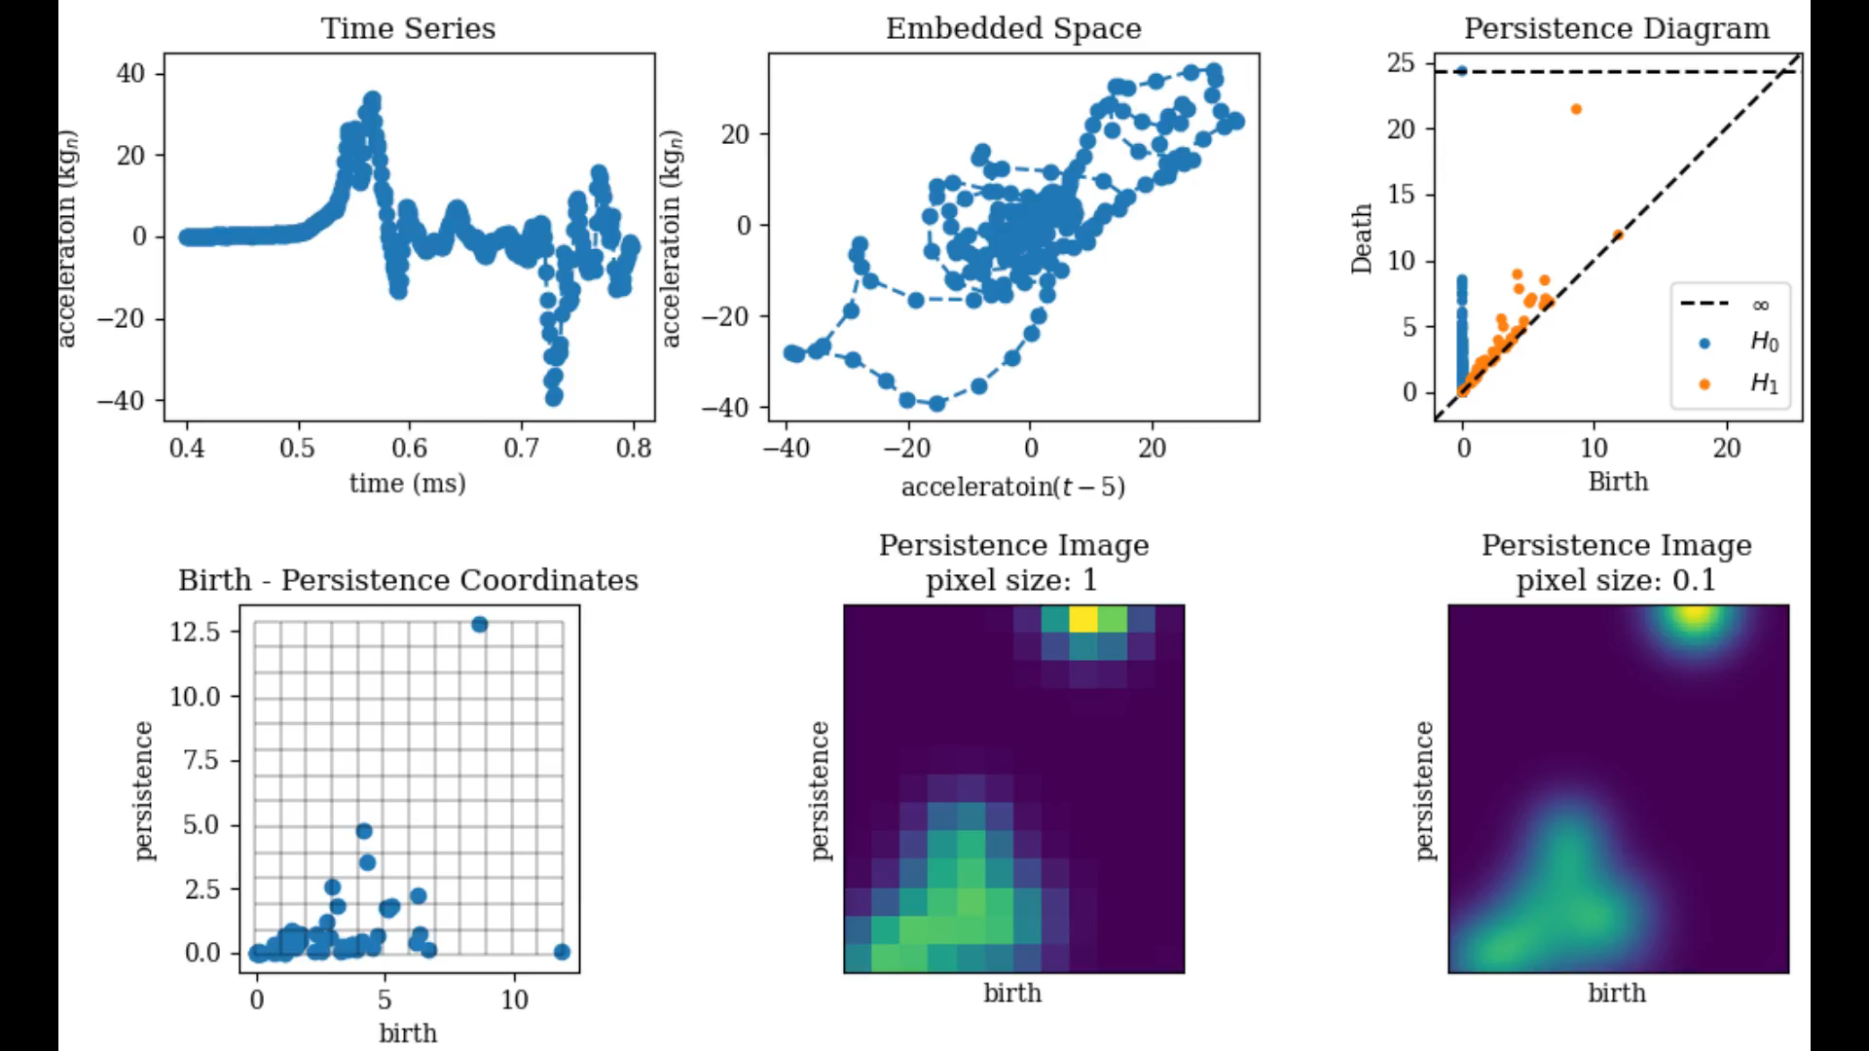
Air Force Data Tau=5, window = 400

Slide 4
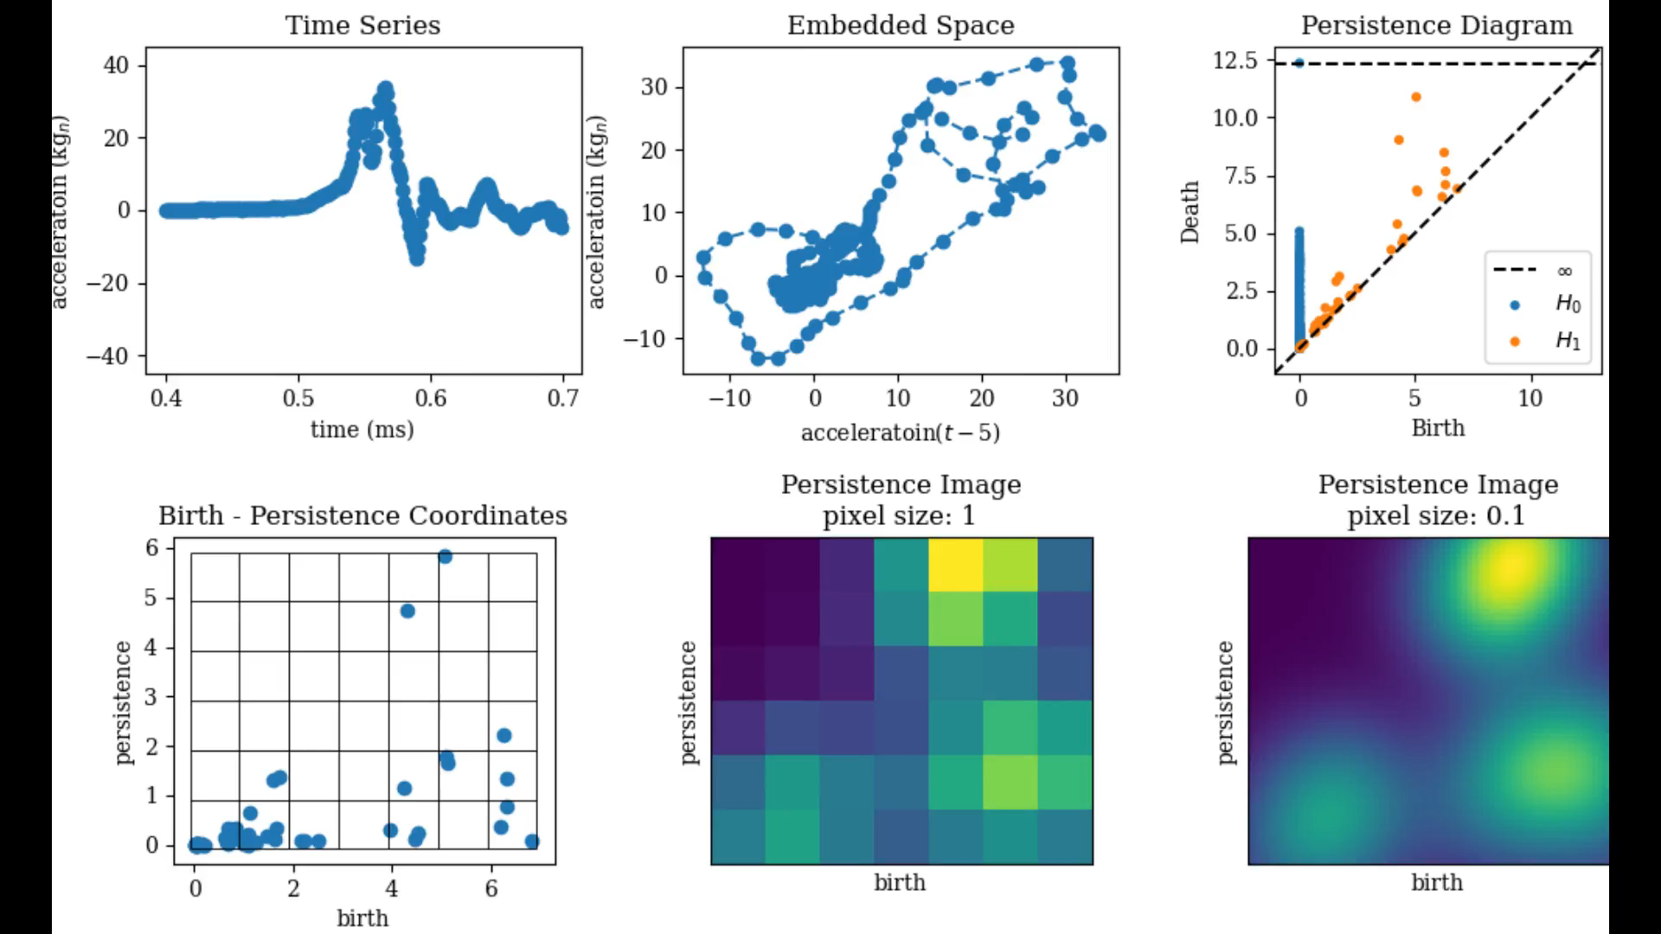
Air Force Data Tau=5, window = 300

Slide 5
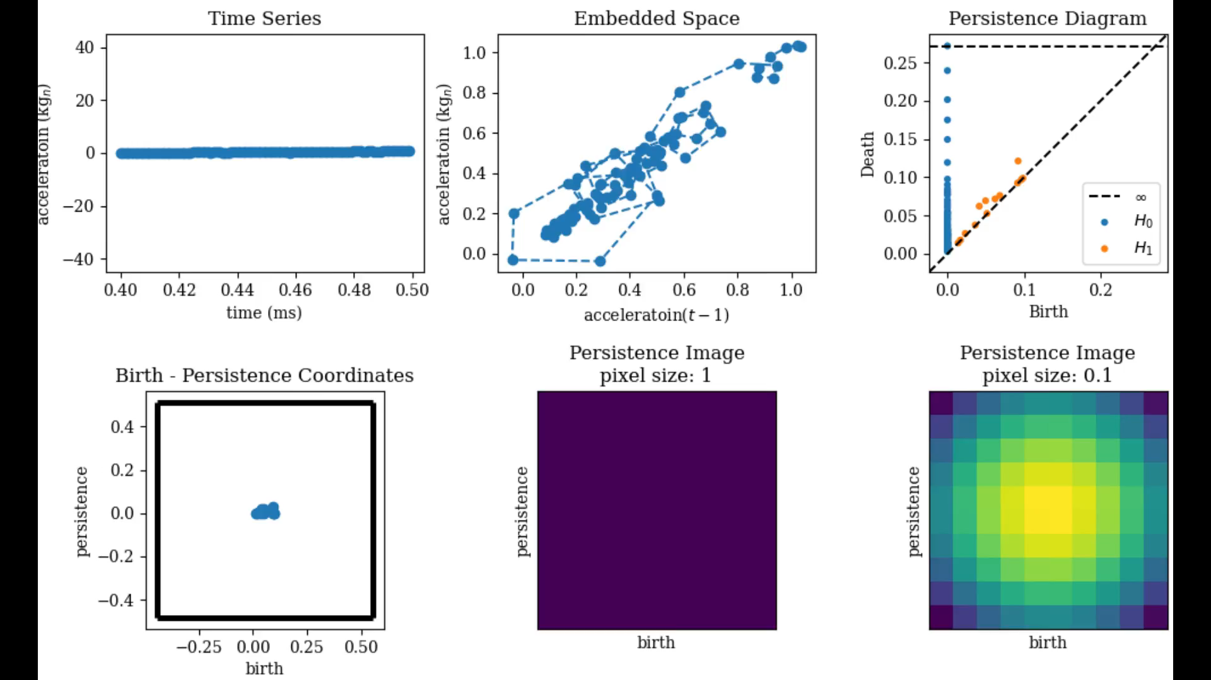
Air Force Data Tau=1

Slide 6
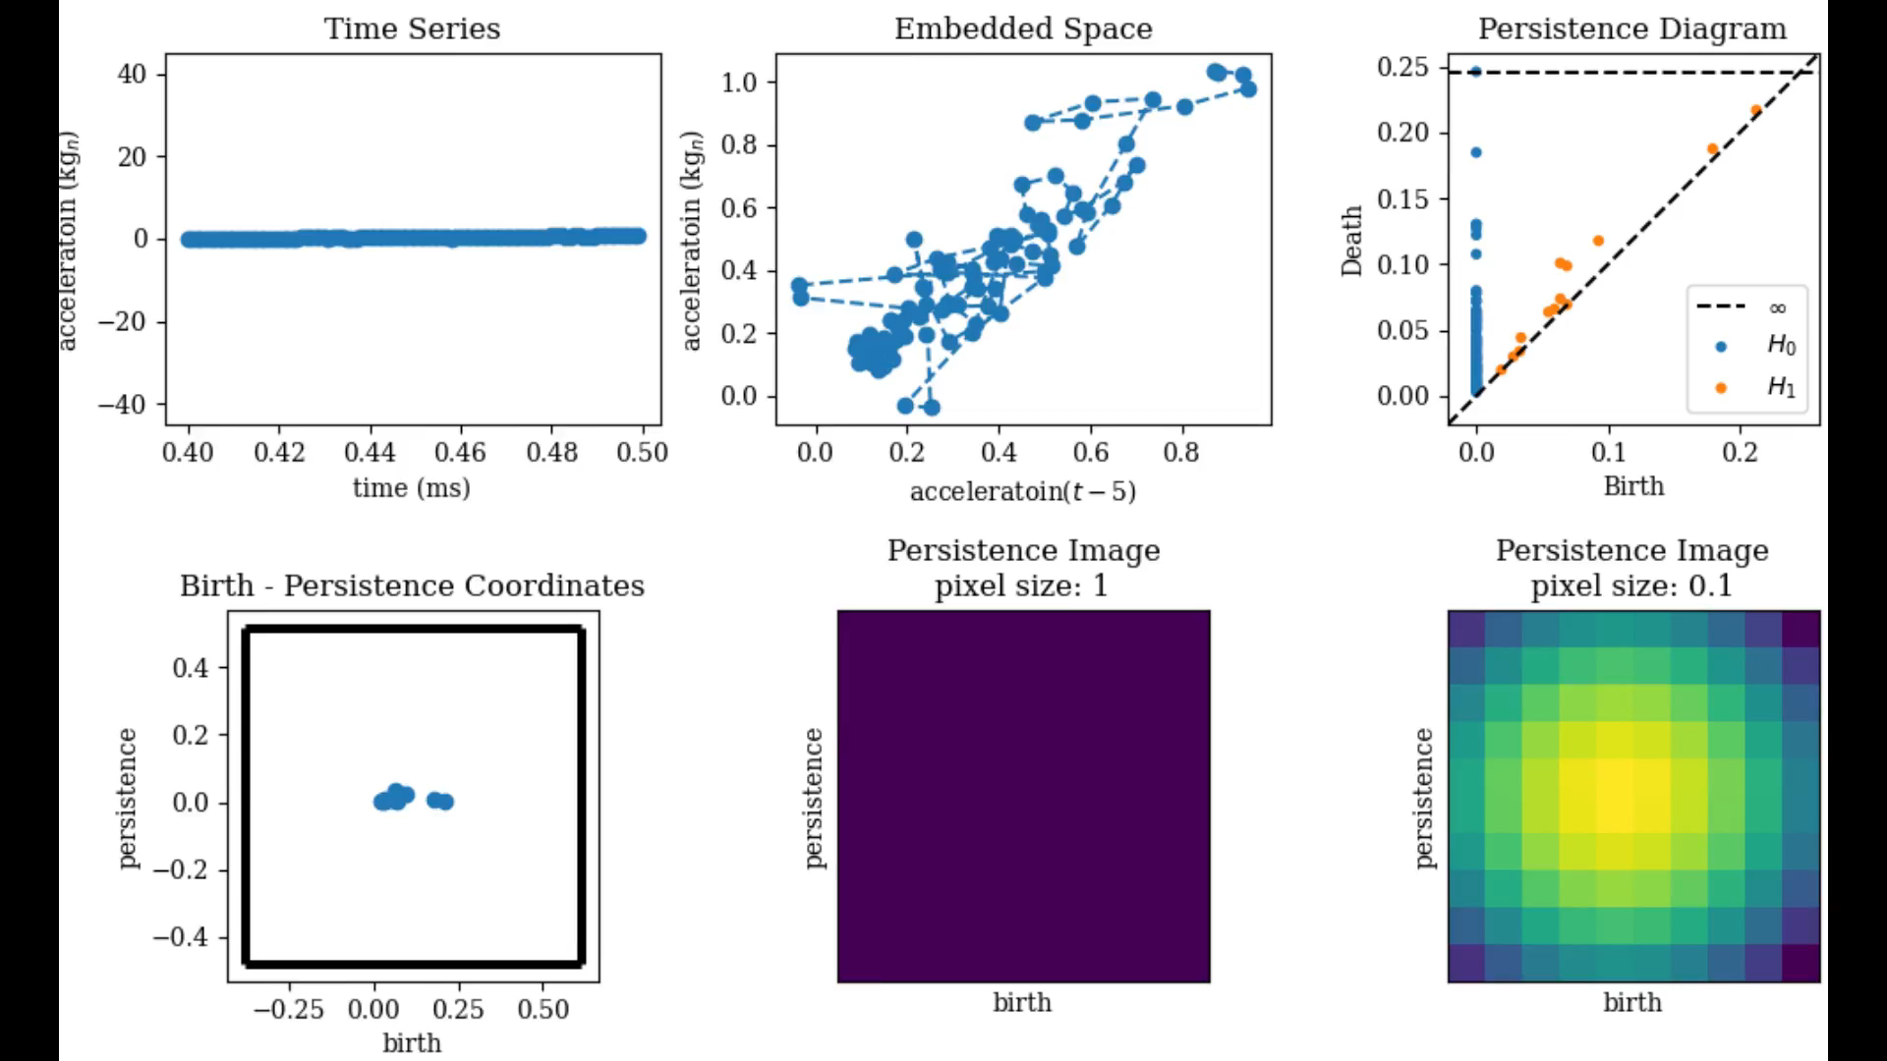
Air Force Data Tau=5

Slide 7

Air Force Data Tau=10

Slide 8
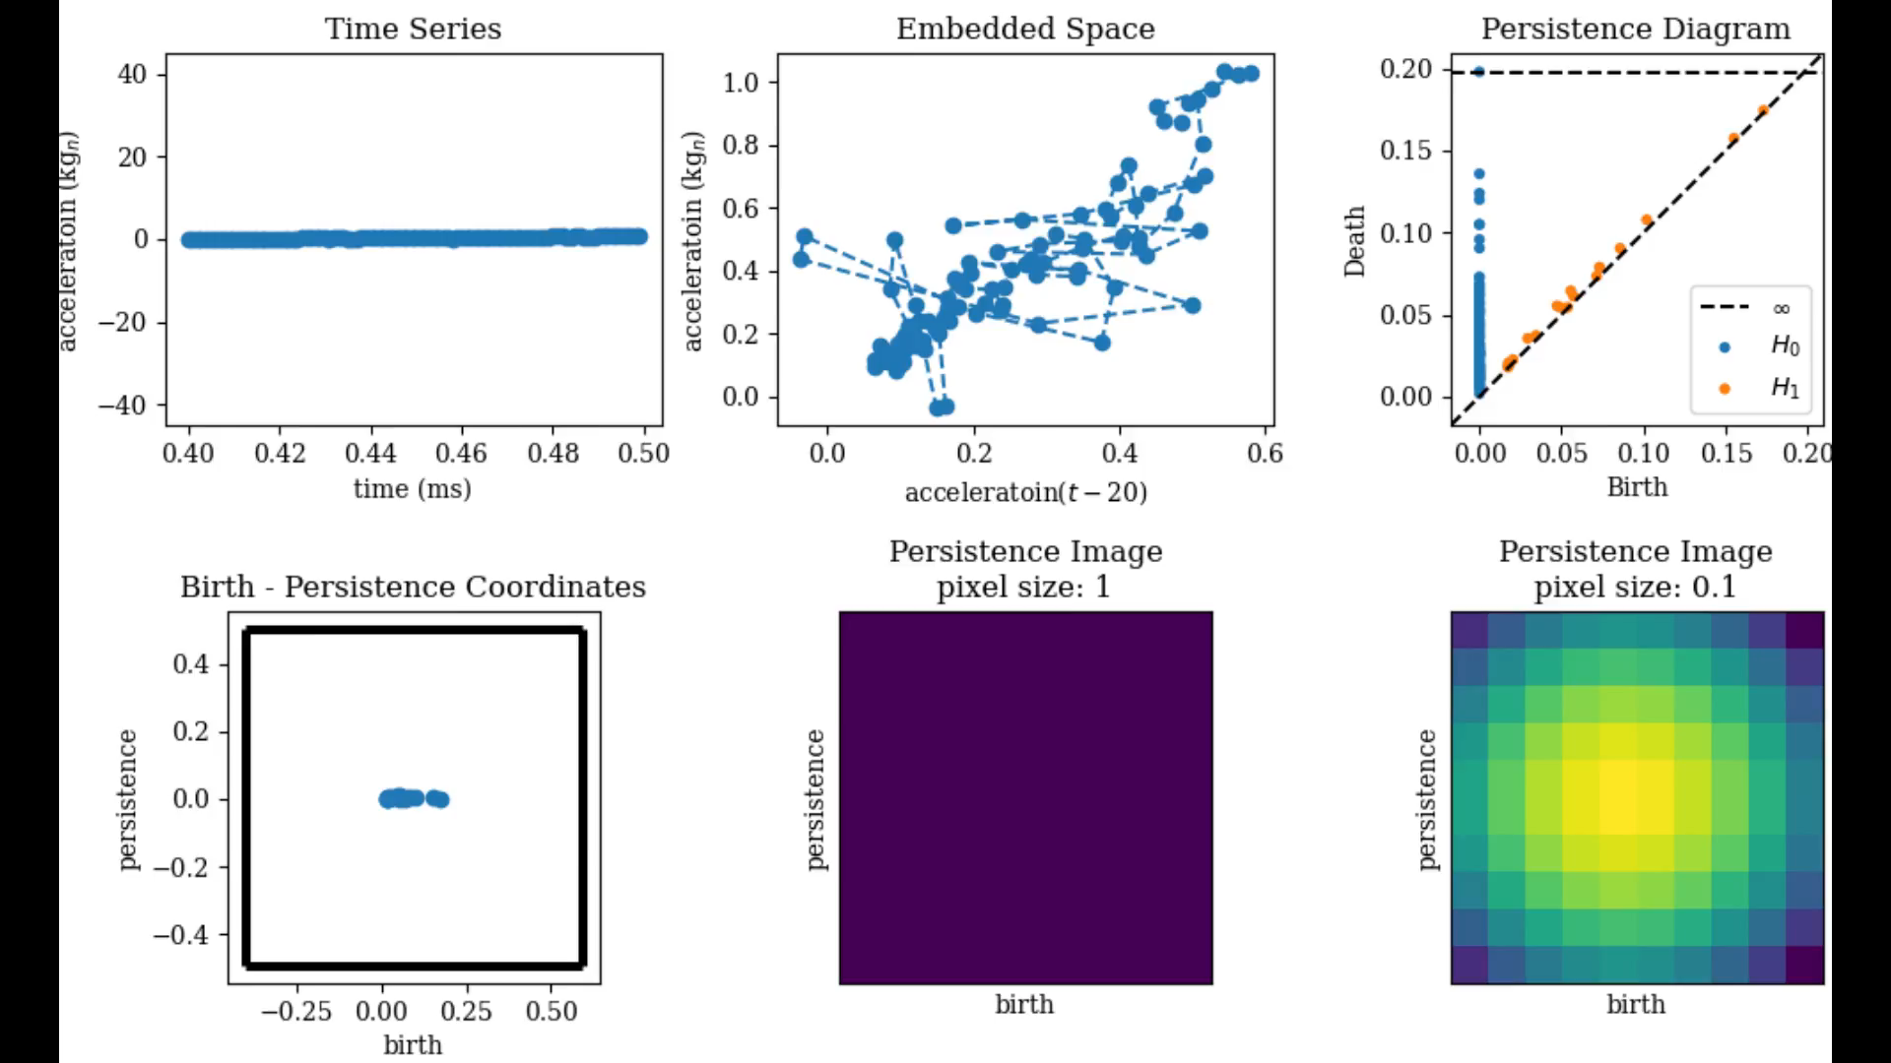
Air Force Data Tau=20

Slide 9
Thanks!
Contact Information
Email: xxx
Github: xxx
Social: xxx

